Slide 1
Driver Alertness Monitoring System

Slide 2
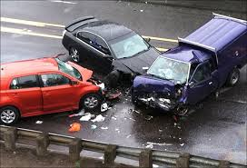
The problem
Every year, up to 20% of road accidents and 25% of fatal accidents are caused by people driving while tired.
Nobody has yet created a method of monitoring how tired the driver is.

Slide 3
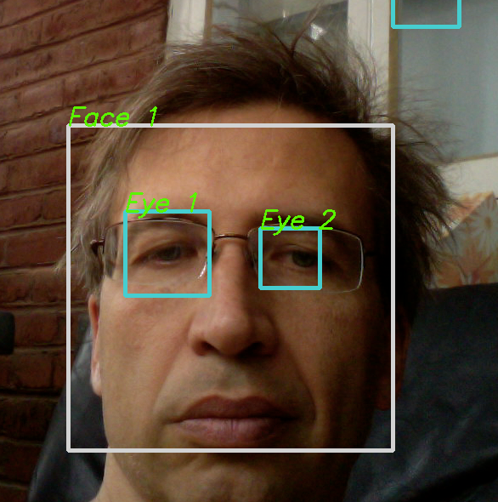
The solution
In recent years, great leaps and bounds have been made in computer science.
One area that is now very advanced is facial and object recognition.
Computers are now able to accurately track objects through a camera in real-time and in 3D.
This could be used to monitor the drivers fatigue.

Slide 4
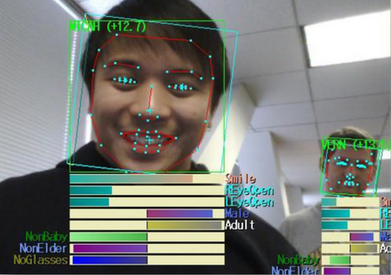
How it will work
A camera inside the car will be able to see the drivers face.
It will monitor which direction they are looking in, how open their eyes are and which way their head is facing.
If they look away from the road for too long, their eyes start to close or their head starts to droop, the system will alert the driver they are losing concentration and recommend they take a break.
This demonstration shows that a camera can accurately track a face, and monitor its tilt (in 3D), and can even work out if the person is wearing glasses and how old they are.

Slide 5
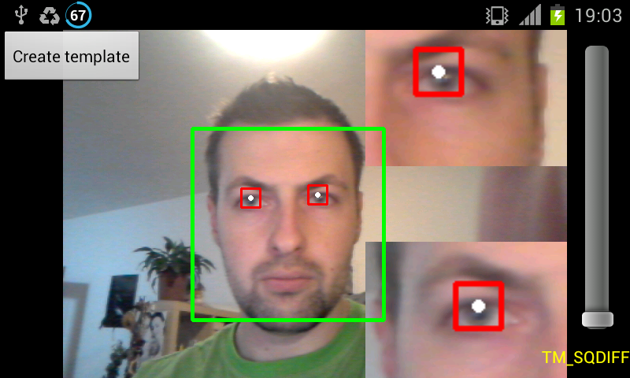
Additional features
As well as tracking objects, some students at MIT have developed software that can amplify colour changes and movement in video, revealing things normally invisible to the normal eye, such as a persons pulse, breathing, and small twitches of the eyes.
This data can reveal a lot about a persons health – if they are sick or intoxicated, and perhaps in the future, whether they are about to faint or suffer a seizure.

